Slide 1
Pug Jump
CPSC236 Final Project
Aiden White

Slide 2
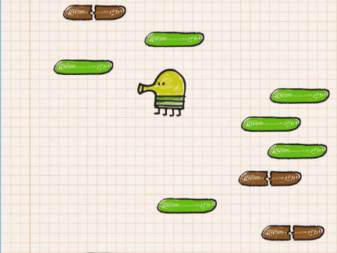
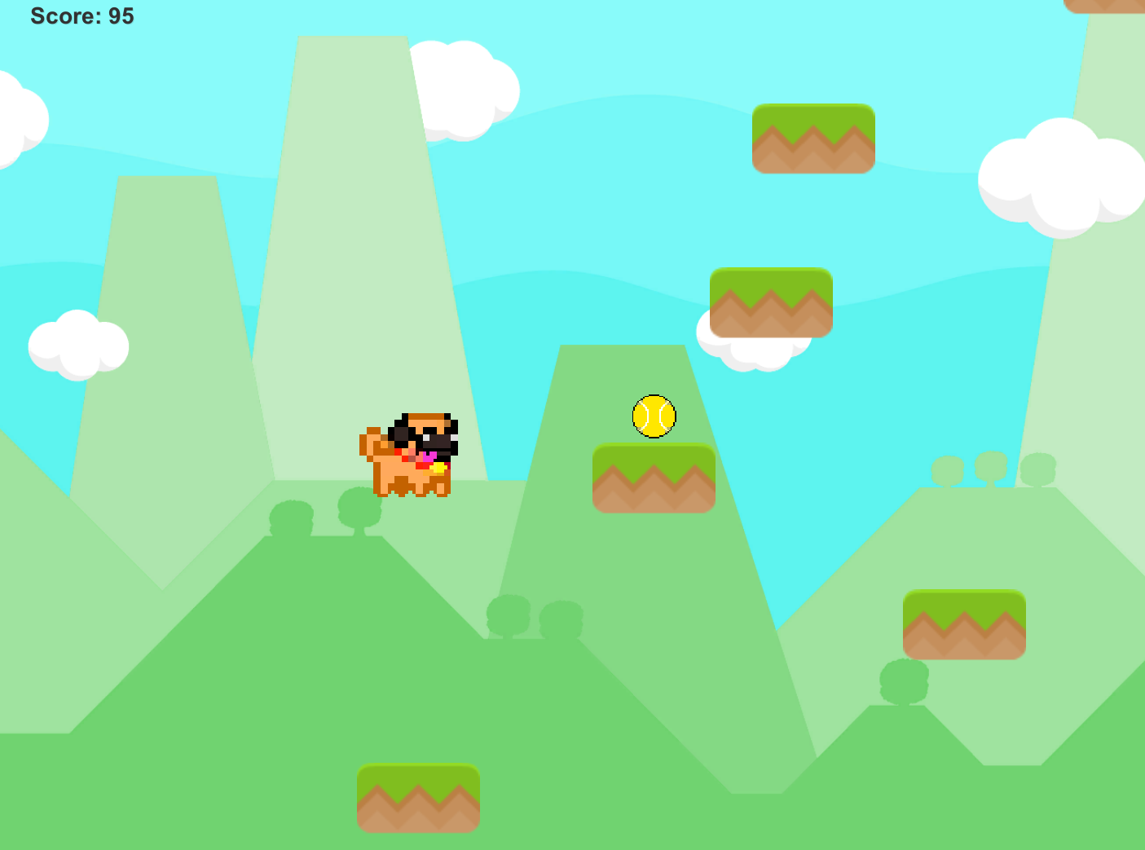
Idea: Doodle Jump Clone
Doodle Jump
My Project
Infinite (Vertical) Platformer

Slide 3

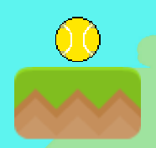
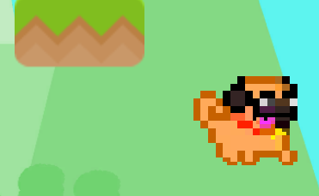
Gameplay
Score increases by moving upwards
Collect bones for extra 10 points
Collect tennis balls for a double jump
Avoid falling or you will restart and score will be reset

Slide 4
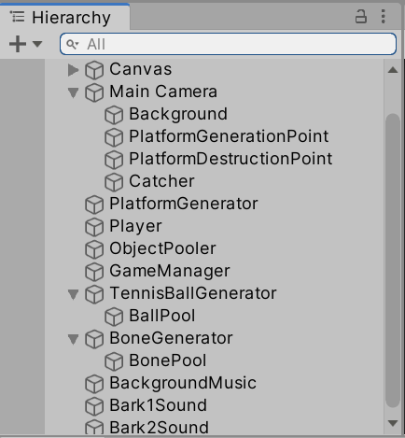
Design Process
Physics and Player Movement
Background and Basic UI
Score
Platform Randomization & Object Pooling
Death/Restart Mechanic
Main & Pause Menu
Power-ups
Music

Slide 5
Things I’m Proud of:
Things I struggled with:
All platforms and powerups are spawned randomly (but powerups always spawn on top of platforms) and they are all pooled to keep the game from running too heavily
The score and death features are very reliable, very few bugs if at all
I think the game is at least somewhat aesthetically appealing (sounds are decent too)
Everything
The pause menu can be accessed via the esc key, but the menu itself does not work
I did not get around to character/sprite selection in the main menu
I also did not get around to adding a hiscore feature
The player animation constantly cycles, it is based on ground contact
Did not end up doing a mobile build

Slide 6
What I learned
It sucks trying to build a game by yourself, and takes an incredibly long time
Sometimes when you add a feature, it completely breaks a bunch of other features and you have to rework them
I learned a lot about working in Unity from YouTube (Brackeys and gamesplusjames are two great channels)
I feel like I now understand why games are always getting delayed from being released

